Slide 1
Study skills/Time management
Student’s Name
Institutional Affiliation
Date

Slide 2
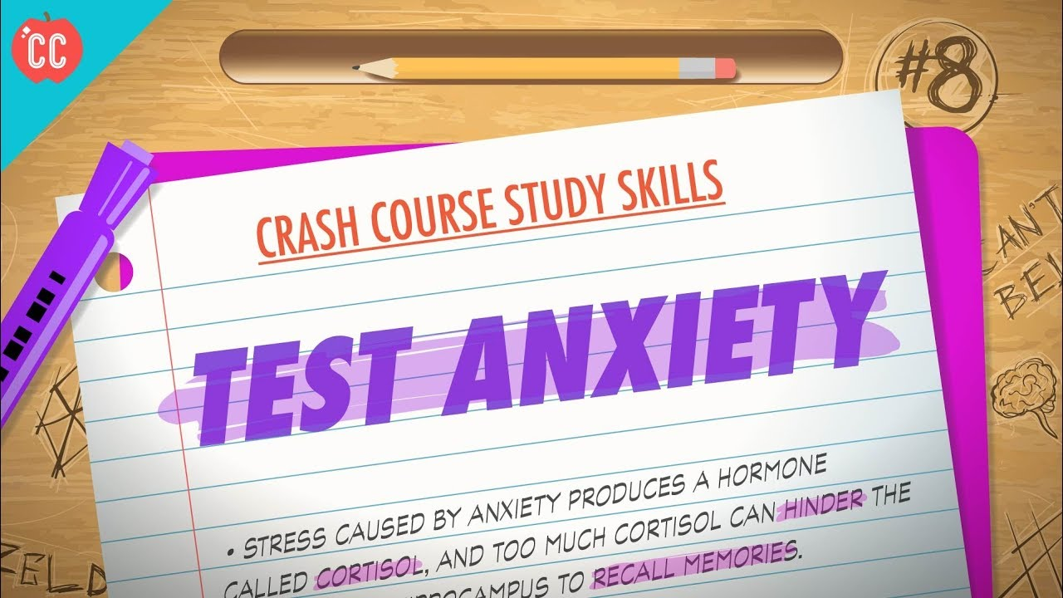

Slide 3
Many students experience some anxiety or stress before taking their exams.
According to the study, a little nervousness can help a person succeeded in their exams but if it becomes so excessive, that can lead to the exam’s performance being interfered with, and this is called test anxiety.
When you get so nervous, it becomes hard for you to even answer the easiest questions cause the mind goes blank.
Excess fear will lead to a lack of concentration and this makes it so difficult to recall or remember the things that you have already studied.
The inability to concentrate also leads to more anxiety and stress which makes it more complicated, difficult, and hard to focus and put more attention on the test.

Slide 4
SYMPTOMS OF TEST ANXIETY
These test anxiety symptoms differ from mild to severe.
This is because some students experience mild symptoms' test anxiety and still manage to tackle their exams fairly well.
We also have other students who are almost incapacitated by their anxiety to an extend of performing dismally on their exams or have panic attacks before their tests.
According to America’s Anxiety and Depression Association, the test anxiety symptoms can be emotional, physical cognitive, and behavioral.
The physical symptoms include nausea, fainting, sweating, dry mouth, rapid heartbeat, and shaking. The anxiety mild cases can lead to stomach butterflies, while more serious cases make the students physically ill (Muller & Kerbow, 2018).
Outright testing situations avoidance or fidgeting are some of the cognitive and behavioral symptoms. Test anxiety can make students drop out the school to avoid the source of their fear (Numan & Hasan, 2017).
The use of substances can also occur when almost all of the students try to take alcohol and prescription medications which are downers as a way of self-treatment. Racing thoughts, difficulty in concentrating on the tests, and negative self-talk are some of the common test anxiety cognitive symptoms.

Slide 5
Emotional symptoms in the test include anger, depression, hopelessness felling, and low self-esteem.
Students can however use different steps to do away with these harmful symptoms by studying more about their test anxiety causes where they begin to look for solutions.
Test anxiety can be caused by a combination of many things such as poor past test performance, underlying anxiety problems, and poor study habits.
Fear of failure: when someone puts their self-worth sense to their test scores, they put so much pressure on themselves that cause severe test anxiety.
Poor testing history: when you have had a poor performance before due to anxiety and poor studying habits before, this may affect all your other coming tests negatively.
Unpreparedness: When you fail to study well enough for the exams, this contributes to more test anxiety.
Test Anxiety can be overcome through the following ways:
I. Getting enough sleep
II. Making sure that you are fully prepared before the exams.
III. Banishing the negative thoughts.
IV. Avoiding the perfectionist trap.
V. Taking deep breaths before the exams.

Slide 6
SKILLS IMPROVEMENT
Skills improvement is the ongoing process that someone goes through in their working period. A new job will always allow you to learn and improve all your skills and you as an individual should always be ready to acquire the chance offered.
It is a fact that technology and people are advancing each day and we must improve our skills to survive in this growing competition.
Some of the top skills that you need to develop your career include:
1.Communication skills (Listening, speaking, and writing).
The first step of skills that employers look for in an employee is the ability to have good communication skills.
2. Analytical and research skills.
Having strong research skills, being analytical differentiates one employee from the other. It shows their determination, their ability to assess different areas, and their commitment percentage to at 100 sure before giving their employers any answer.
3. Flexibility/adaptability.
This is the ability to manage many assignments at the same time and having the flexibility to work under the ever-changing environment, management, rules, and conditions (Acomi, 2018).
4. Interpersonal abilities.
Having interpersonal skills is an added advantage to a working team, helps them in dealing with suppliers or clients and this is something that all employers look for.
5. Ability to make decisions and solve problems.
Solving problems and making the right decisions is one of the skills that are in high demand in workplaces.

Slide 7
6. Ability to plan, organize and prioritize work.
An individual being in a position to organize their work well is very valuable to the work. People should pay attention to the way that they plan their tasks, and make sure that they keep up with all the deadlines that are put in place.
7. Ability to wear multiple hats.
An employee should be able to interact with other areas of business and understanding the different steps used. They should also be able to provide help where necessary.
8. Leadership/management skills.
It is a very powerful skill to manage people. You can guide them along, inspire them to do what is right, and monitor every step of their way.
9. Attention to detail.
An employee having the ability to pay attention to every detail of a business organization can save it from a very catastrophic outcome.

Slide 8

10. Self-confidence.
You need to be confident about yourself and ensure that all the people around you see your potential and ability to tackle and handle different situations and all problems that come your way.
11. Public speaking.
12. Tactfulness.
13. Creativity.
14. Ethics and integrity.
15. Strong work ethic.
16. Ability to accept and learn from criticism.
17. Sales and marketing.
18. Computer and electronics skills.
19. Mathematics.
20. Programming.

Slide 9
TIME MANAGEMENT (SCHOOL/HOME/HOMEWORK/AFTER SCHOOL ACTIVITIES)
Managing time effectively is an important skill for every student.
Time management is an art that every student should master.
Good time management skill assists the student in prioritizing tasks hence being able to complete assignments and school work on time.
We have students who decide planning ahead of the teacher and setting more time aside to tackle their projects and assignments by making use of that time.

Slide 10
Time management tips for students
1.Creating a Master Schedule
Making a master schedule that your child can put into use to manage time to work on their assignments and deliver on time is very important.
2.Use an Agenda
Children should be helped in looking ahead at all the upcoming assignments and record the due dates on the agenda (Stoeger & Ziegler, 2008).
3.Eliminate Distractions
Distractions that can block children from studying well include friends, social media, and cell phones and should be eliminated

Slide 11

4.Set Goals for Each Study Session.
5.Start Working on Assignments Early.
6.Make a Project Plan-Creating a project plan helps students in avoiding last-minute panic.
7.Work on One Thing at A Time.
8.Study in Shorter Bursts.
9.Start Early in The Day.
Children should be encouraged to do their assignments earlier in the day or immediately after school.
10.Get 8-10 Hours of Sleep
Your child getting enough sleep is very important because this recharge their mind has the energy that is required to stat on track the following day.

Slide 12
Career Counseling Information
Career counseling is a process that helps an individual know and understands themselves and the work environment to make career, educational, and life decisions.
Career development involves more than just making a major decision and the type of job to get after graduating.
This is usually a lifelong process which means that throughout someone's life, situations change, they change and they will keep making career and life decisions.
The main aim of Career Counselling is to help someone make decisions that they need in their current life, and provide them with future skills and knowledge to make good decisions in the future.
Your Career Counselor WILL:
Helps an individual identify all the factors influencing their career development, and help them assess their values, abilities, and interests.
Help them locate career information sources and resources. They also help individuals determine the next steps and create a plan to achieve their goals.

Slide 13

HOW MIGHT A PARENT BE PART OF THEIR CHILD'S EDUCATIONAL PROCESS
Successful involvement of a parent in their Child's Educational Process can be described as the active ongoing parent or primary caregiver participation in their education of their children.
Parents can clearly show this involvement at home by attending functions or volunteering in classrooms and discussing school events-or at school.
All the schools that have involved parents, they engage them by communicating effectively with them and incorporating them into learning classes (Acomi, 2018).
How do schools foster successful parent involvement?
Improve Communication
Effective communication needs a flow of information between two parties.
Some schools develop sharing of information through the use of websites, interactive phone systems, e-mail messages, newsletters, and press releases which ensures feedback from both parties including the parents.

Slide 14
References
Acomi, N. (2018). Developing a System for Recognition of Work-Related Skills and Learning Outcomes. Revista Românească pentru Educaţie Multidimensională, 10(2), 102-111.
Brown, D., & Brown, D. (2012). Career information, career counseling, and career development. Boston, MA: Pearson.
Muller, C., & Kerbow, D. (2018). Parent involvement in the home, school, and community. Parents, their children, and schools (pp. 13-42). Routledge.
Numan, A., & Hasan, S. S. (2017). Effect of Study Habits on Test Anxiety and Academic Achievement of Undergraduate Students. Journal of Research & Reflections in Education (JRRE), 11(1).
Stoeger, H., & Ziegler, A. (2008). Evaluation of classroom-based training to improve self-regulation in time management tasks during homework activities with fourth graders. Metacognition and Learning, 3(3), 207-230.

